Slide 1
統計計算
期中報告
R11H41009 趙俊程
Started

Slide 2
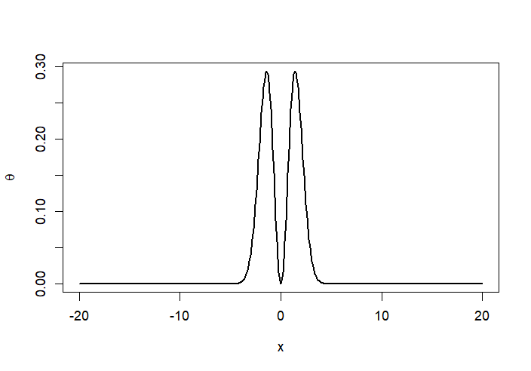

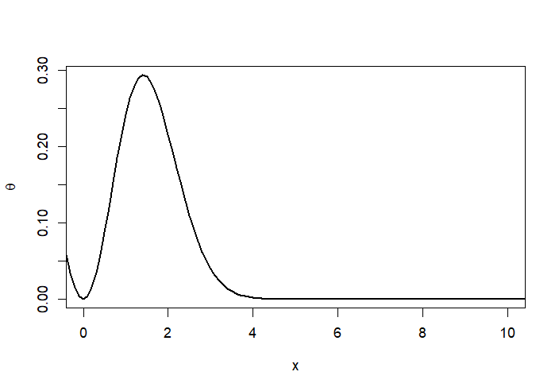
函數特徵
計算真實值、函數分布
g <- function(x) {(x^2/sqrt(2*pi))*exp(-x^2/2)}
set.seed(1999)
n <- 10000
true <- integrate(g, 1, Inf)$value
#exact value is 0.400626
D <- seq(-20,20,0.1)
# symmetric function
plot(d,(d^2/sqrt(2*pi))*exp(-d^2/2),lwd=2,ylab=expression(theta),xlab='x')
plot(d,(d^2/sqrt(2*pi))*exp(-d^2/2),lwd=2,xlim=c(0,10),
ylab=expression(theta),xlab='x')

Slide 3
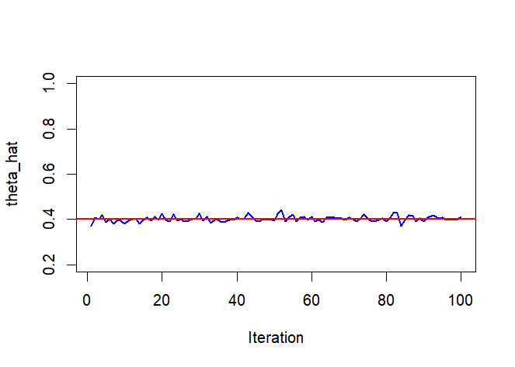
1.Direct Monte Carlo method
#1
n <- 10000
R <- 100 #模擬次數
g <- function(x){
(x^2)*(x>1)
}
true <- 0.400626
integrals <- numeric(100)
for(i in 1:R){
x <- rnorm(n)
integrals[i] <- mean(g(x))
}
g
theta1 <- mean(integrals)
var1 <- var(integrals)/R
print(c(theta1,var1))
plot(1:R, integrals,type= 'l',col = 'blue',xlab='Iteration', ylim=c(0.2,1),
ylab ='theta_hat', lwd =2)
abline(a=true,b=0,col='red',lwd=2)
[1] 4.021659e-01 1.547740e-06

Slide 4
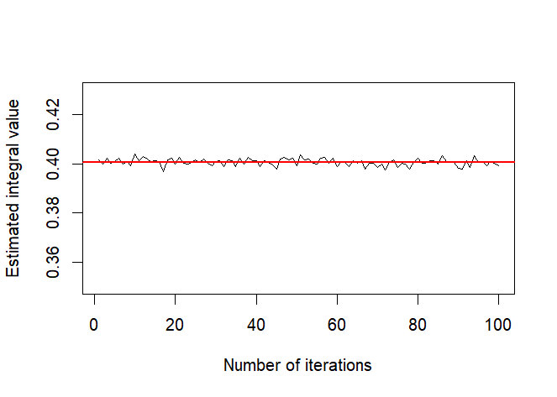
2.Importance sampling method
#2
# Importance sampling method
g <- function(x) {(x^2/sqrt(2*pi))*exp(-x^2/2)}
f <- function(x) {exp(-(x-1))}
# 重要性分布 shift exp(1) to 1
integrals_2 <- numeric(100)
set.seed(100)
n <- 10000
true <- 0.400626
for ( i in 1:R){
x <- rexp(n,1) +1
weit <- g(x) / f(x)
integrals_2[i] <- mean(weit)
}
theta2_1 <- mean(integrals_2)
var2_1 <- var(integrals_2)/R
print(c(theta2_1, var2_1))
plot(1:R, integrals_2, type="l", xlab="Number of iterations", ylab="Estimated integral value",ylim=c(0.35,0.43))
abline(a=true,b=0,col='red',lwd=2)
[1] 4.006902e-01 2.104583e-08
Notes:
計算每個樣本 x_i 在目標分布 p(x) 和重要性分布 q(x) 下的概率比值作為權重

Slide 5
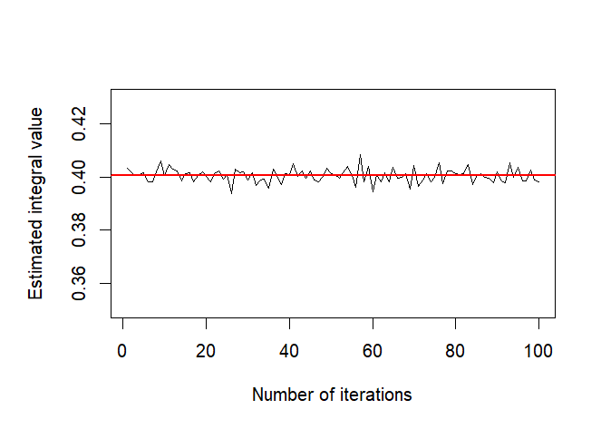
2.self-normalized importance sampling methods.
# self-normalized var減少但是偏誤
w <- g(x)/f(x)
integrals_2_2 <- numeric(100)
p <- w / sum(w)
for (i in 1:R){
x <- rexp(n,1) +1
x.star <- sample(x, size=n, prob=p, replace=TRUE)
p <- w /sum(w) # 權重歸一化
weit <- g(x.star) / f(x.star)
integrals_2_2[i] <- mean(weit)
}
theta2_2 <- mean(integrals_2_2)
var2_2 <- var(integrals_2_2)/R
print(c(theta2_2, var2_2))
par(mar=c(5, 5, 4, 2) + 0.1)
plot(1:R, integrals_2_2, type="l", xlab="Number of iterations", ylab="Estimated integral value",ylim=c(0.35,0.43))
abline(a=true,b=0,col='red',lwd=2)
[1] 4.626626e-01 1.947875e-08
Notes:
每個樣本的權重被除以所有樣本權重的總和，使得歸一化後的權重之和為1。根據它們在目標函數 g(x) 中的相對重要性對樣本點進行重新抽樣。

Slide 6

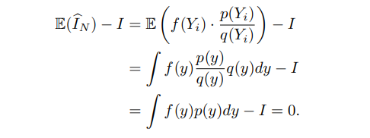
1.Is there any difference between two methods?
self-normalized重要性抽樣通常可以獲得更好的估計結果，因為它通過將更多的抽樣集中在目標函數值較大的區域來改進抽樣策略。可以降低變異數但代價是self-normalized importance sampling methods有時會產生偏誤的估計。
2.Which one is an unbiased estimator?
Importance sampling method

Slide 7
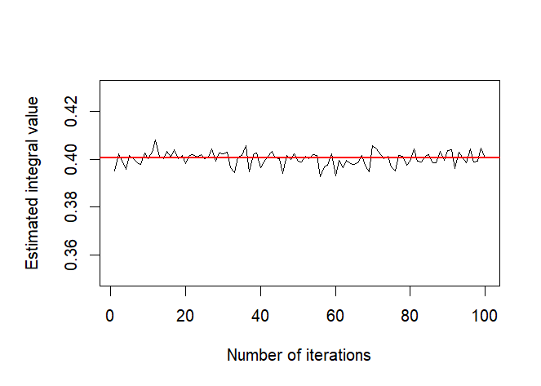
3.Variable transformation of the integrand to a interval of [0, 1]
# transformation of the integrand to a interval of [0, 1] u=1-1/x
g <- function(x) {(x^2/sqrt(2*pi))*exp(-x^2/2)}
trans_g <- function(u) {
x <- 1/(1 - u)
jacobian <- 1/((1 - u)^2)
return (g(x) * jacobian)
}
integrals_3 <- numeric(100)
for(i in 1:R){
x <- runif(n)
integrals_3[i] <- mean(trans_g(x))
}
theta3 <- mean(integrals_3)
var3 <- var(integrals_3)/R
print(c(theta3,var3))
plot(1:R, integrals_3, type="l", xlab="Number of iterations", ylab="Estimated integral value",ylim=c(0.35,0.43))
abline(a=true,b=0,col='red',lwd=2)
[1] 4.002868e-01 8.573414e-10
Notes:
u=exp(1-x)

Slide 8
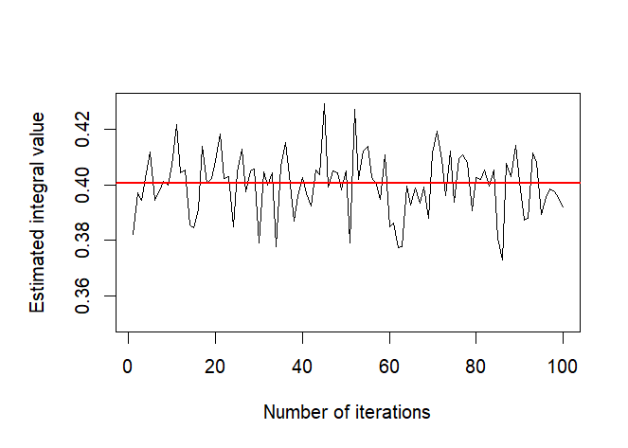
4. Two control variates
n <- 10000
integrals_4 <- sigma <- numeric(100)
g <- function(x){
(x^2)*(x>1)
}
f1 <- function(x){
dgamma(x,shape=2,scale=2)
}
f2<- function(x){
0.5*(x^2 + (1-x)^2)
}
theta.hat <- se <- numeric(2)
for(i in 1:R){
x <- rnorm(n)
L <- lm(g(x) ~ f1(x) + f2(x))
c.star <- -c(L$coeff[2],L$coeff[3])
mu1 <- mean(f1(x))
mu2 <- mean(f2(x))
integrals_4[i] <- sum(L$coefficients*c(1,mu1, mu2))
}
theta4 <- mean(integrals_4)
var4 <- var(integrals_4)/R1]
print(c(theta4,var4)) 4.019726e-01 1.428074e-06
plot(1:R, integrals_4, type="l", xlab="Number of iterations", ylab="Estimated integral value",ylim=c(0.35,0.43))
abline(a=true,b=0,col='red',lwd=2)

Slide 9
5.Stratified Sampling
set.seed(1999)
g <- function(x) {(x^2/sqrt(2*pi))*exp(-x^2/2)}
stra <- function(k){
n <- 10000
N <- 50
T2 <- numeric(k)
estimates <- matrix(0,N,2)
for (i in 1:N){
estimates[i,1] <- 0.5-mean(g(runif(n)))
for(j in 1:k){
T2[j] <- 0.5-mean(g(runif(n/k, (j-1)/k, j/k)))
}
estimates[i,2] <- mean(T2)
}
return (estimates)
}
estimates_10 <- stra(k=10)
apply(estimates_10,2,mean) #0.4006631 0.4006315
apply(estimates_10,2,var) #5.398601e-07 6.902123e-09
estimates_1000 <- stra(k=1000)
apply(estimates_1000,2,mean) #0.4007636 0.4006259
apply(estimates_1000,2,var) #9.427131e-07 6.771316e-13
Notes:
b. 執行 k 次分層抽樣： i. 將區間 [0, 1] 分成 k 個相等的子區間。 ii. 在每個子區間中獨立抽樣： - 從當前子區間中隨機抽取 n/k 個樣本。 - 計算函數 g(x) 在這些樣本上的平均值。

Slide 10
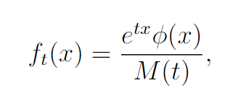
6. Use the tile density of standard normal distribution as the importance function given by
where φ is the standard normal distribution and M (t) is the MGF of φ. Discuss the effect of t, −∞ < t < ∞

Slide 11
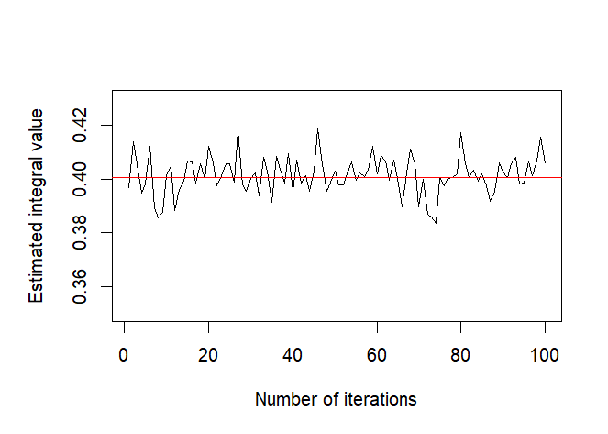
n <- 10000
g <- function(x) {
(x^2 * exp(-0.5*x^2) / sqrt(2*pi)) * (x>1)
}
ft <- function(t,x){
(exp(t*x)*(1/sqrt(2*pi))*exp(-x^2/2))/exp((t^2)/2)
}
integrals6 <- numeric(100)
t <- 3
for(i in 1:R){
u <- runif(n)
x <- t + qnorm(u)
fg <- g(x)/ft(t,x)
integrals6[i] <- mean(fg)
}
theta6 <- mean(integrals6)
var6 <- var(integrals6)/R
print(c(theta6,var6))
plot(1:R, integrals6, type="l", xlab="Number of iterations", ylab="Estimated integral value",ylim=c(0.35,0.43))
abline(a=0.40062,b=0,col='red')
[1] 4.007649e-01 5.564904e-07
Notes:
用 inverse transform 隨機生成ft(x) 的x

Slide 12
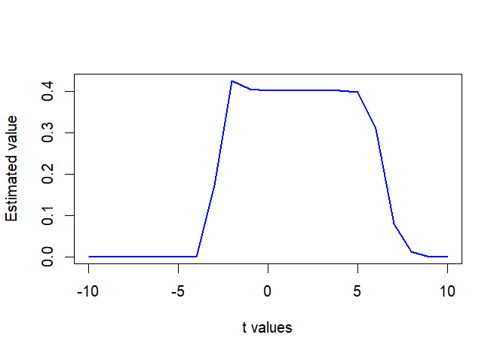
n <- 10000
R <- 100 #模擬次數
g <- function(x) {
(x^2 * exp(-0.5*x^2) / sqrt(2*pi)) * (x>1)
}
ft <- function(t,x){
(exp(t*x)*(1/sqrt(2*pi))*exp(-x^2/2))/exp((t^2)/2)
}
t_values <- seq(-10, 10, by=1) # t值從-10到10
results <- matrix(0, length(t_values), 2)
for (t_index in 1:length(t_values)) {
t <- t_values[t_index]
integrals <- numeric(R)
for(i in 1:R){
u <- runif(n)
x <- t + qnorm(u)
fg <- g(x)/ft(t,x)
integrals[i] <- mean(fg)
}
results[t_index, 1] <- mean(integrals)
results[t_index, 2] <- var(integrals)/n
}
plot(t_values, results[,1], type='l', col='blue', xlab='t values', ylab='Estimated value', lwd=2)
t 值較大的時候，標準常態分佈結果的精確度降低。在 x 軸右側的機率密度值趨近於 0，導致重要性抽樣的權重變得非常小，導致估計不准。
在 t 值較小的時候，標準正態分佈在 x 軸右側的機率密度值比較大，使得重要性抽樣的權重變得比較大，但此時 g(x) 的形式與標準正態分佈的形式差異較大，也會降低估計結果的精確度。

